Slide 1
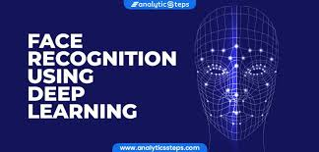
Face detection & recognition in organic video : a comperative study for sport celebraties database -using deeplearning
PRESENTED BY
N BHASKAR NAYAK - 20Q91A05I9
B VINEELA - 20Q91A05J2
M SUNAYANA - 20Q91A05I4
K NIKHIL VARMA - 20Q91A05L2

Slide 2
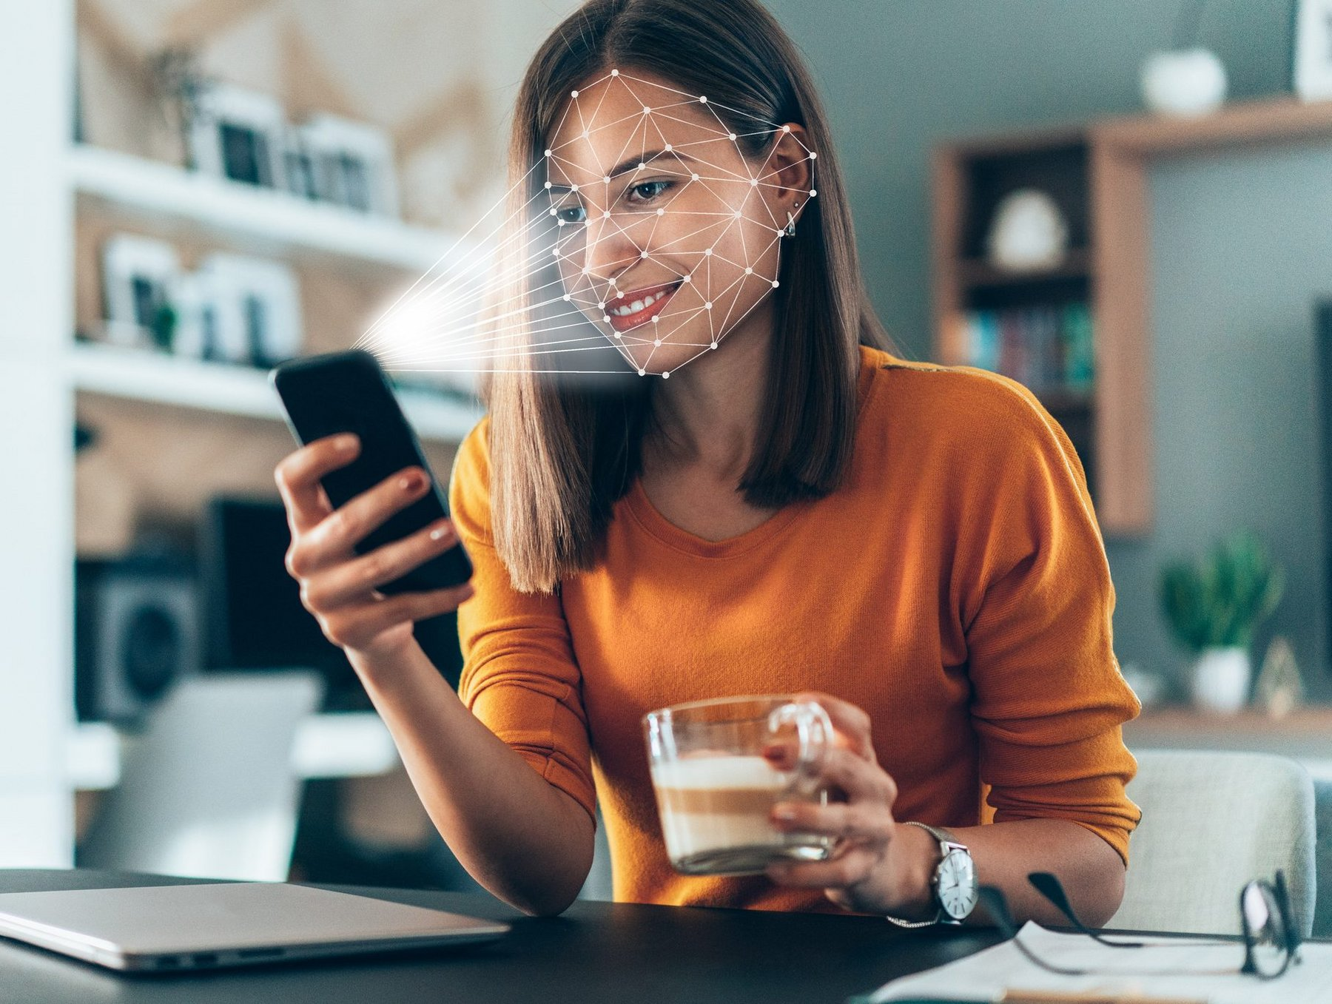
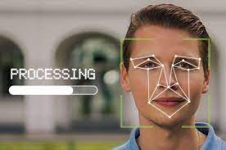
CONTENTS
ABSTRACT
KEYWORDS
INTRODUCTION
OBJECTIVE
EXISTING SYSTEMS
DRAW BACKS
ADVANTAGES
APPLICATIONS
PROPOSED SYSTEMS
SYSTEM ARCHITECTURE
MODULES
SYSTEM REQUIREMENTS

Slide 3
ABSTRACT
Now-a-days with the continued development of artificial intelligence face detection and recognition has become more popular. The face recognition plays a major role in interaction technology. In interaction technology the verbal components only play a one third of communication and the non-verbal components plays a two third of communication. A facial Detection recognition (FDR) method is used for detecting face detection. Face detection plays a major role in recognizing the the face of the person. Here proposes a real time face recognition system based on You Look Only Once (YOLO) version 2 architecture and a squeezenet architecture. The yolo architecture is a real time object detection system. Here it used for identify and detect faces in real time. These images are captured by using anchor boxes for accuracy. The second architecture is squeezenet and is used for gender classification and age estimation. It provides significant, accurate object detection and extracts high-level features that help to achieve tremendous performance to classify the image and detecting objects. Both the architectures provide accurate result than other methods with the large no of hidden layers and cross validation in the neural network.

Slide 4
KEY WORDS
Face detection,
Face recognition,
Organic video
You Look Only Once (YOLO) architecture
Squeezenet architecture

Slide 5
AIM
To detect and recognize face in organic video : a comperative study for sport celebraties database

Slide 6
OBJECTIVE
The main objective of face recognition is to find a series of a data of the same face in a set of a training images in a datatbase
A facial recognition system is a computer application for automatically identifying or verifying a person from a digital image from the source .
One of the ways to do this is by comparing selected facial features from the image and a facial database.
Four stages of identification :
Capture : Capture the behavioral sample
Extraction : unique data is extracted from the sample and a template is created
Comparison: the template is compared with a new sample
Match/Non-Match: the system decides whether the new sample are matched or not

Slide 7
INTRODUCTION
In today’s networked world , the need to maintain the security of information or the physical property is becoming both increasingly important and increasingly difficult . Face recognition is the biometric methods that posses the merits of high accuracy .complex ana largely software based technique analyze unique shape , pattern & positioning of facial features . It compares scans to record stored in central or local database or even on a smart card.
What is biometric ?
It is a unique measurable characteristics of human being
It is used to automatically recognize an individual’s identity
A biometric system refers to integrated hardware and software used to conduct biometric identification

Slide 8
Existing System
The face recognition plays a major role in Identification of face. In interaction technology the verbal components only play a one third of communication and the non-verbal components plays a two third of communication. A facial Detection recognition (FDR) method is used for detecting facial Detection . Face Detection plays a major role in recognition face and helpful for the securing of data using face
YOLO and Sueezenet architecture

Slide 9
Draw Backs of existing system
Problem with false rejection when people change their hair style , grow or shave a beard or wear glasses.
Face recognition systems can’t tell the difference between identical twins

Slide 10
PROPOSED SYSTEMS
This paper aims to identify basic human Face detection with the combination of gender classification and age estimation.
Here proposes a real time facial emotion recognition system based on You Look Only Once (YOLO) version 2 architecture and a squeezenetarchitecture.
The yolo architecture is a real time object detection system. Here it used for identify and detect faces in real time. These images are captured by using anchor boxes for accuracy.
The second architecture is squeezenetand is used for gender classification and age estimation.
It provides significant, accurate object detection and extracts high-level features that help to achieve tremendous performance to classify the image and detecting objects.
Both the architectures provide accurate result than other methods with the large no of hidden layers and cross validation in the neural network

Slide 11
Advantages
Convenient , social acceptability
More user friendly
Inexpensive technique of identification
Secures the data

Slide 12
APPLICATIONS
Time attendance and user authentication
Social media profile moderation and verification
Reducing online banking fraud
Making an entrance at events
Biometric border checks in Europe ……..and many more

Slide 13
SYSTEM ARCHITECTURE
Yolo Y2
Output Image with Image detection
Real Time Input Image
Processing
Image detected
Squeezenet Architecture

Slide 14
MODULES
Upload Facial Recognition Dataset : First we need to upload the face of sport celebraty
Preprocess the dataset :then we need to preprocess the data
Train the CNN Algorithm with the Yolo faces : in this step we need to train the dataset using yolo2
Accuracy Comparison graph: the graph will be giving us information to that accuracy of the face detection
Predict the facial Detection : finally we need to predict the real face

Slide 15
SYSTEM REQUIREMENTS
Hardware Requirements
Software Reqirements
System : Pentium Dual Core
Hard Disk : 120GB
Monitor : 15’’LED
Input Devices : Keyboard , Mouse
Ram : 1GB
Operating system : Windows 10
Coding language : Python
Tool : PyCharm
Database : MYSQL
Server : Flask

Slide 16
CONCLUSION
The use of machines in society has increased widely in the last decades. Nowadays, machines are used in many different industries. As their exposure with human’s increase, the interaction also has to become smoother and more natural. In order to achieve this, machines have to be provided with a capability that let them understand the surrounding environment. Specially, the intentions of a human being. Emotion recognition is still a difficult and a complex problem in computer science because every expression is a mix of emotions. Here proposed an efficient real time facial expression recognition system with the combination of two algorithms such as yolo version 2 and squeezenet architecture based on deep neural networks for more accurate and efficient facial expression recognition. The future scope can be an action that is done upon recognition of the emotions. If get a sad emotion, can have the systems plays a song or tells a joke or send his/her best friend a message. This can be the next step of AI where the system can understand, comprehend the user’s feelings and emotions and react accordingly. This bridges the gap between machines and humans. We can also have an interactive keyboard where the users can just use the app and the app will then identify the emotion and convert that emotion to the emoticon of choice.

Slide 17
REFERENCES
[1] Jumani, S.Z., Ali, F., Guriro, S., Kandhro, I.A., Khan, A. and Zaidi, A., 2019. Facial Expression Recognition with Histogram of Oriented Gradients using CNN. Indian Journal of Science and Technology, 12, p.24.
[2] J. R. Barr, L. A. Cament, K. W. Bowyer, and P. J. Flynn. Active clustering with ensembles for social structure extraction. In Winter Conference on Applications of Computer Vision, pages 969–976, 2014
[3] Ren, S., He, K., Girshick, R. and Sun, J., 2015. Faster r-cnn: Towards real-time object detection with region proposal networks. In Advances in neural information processing systems (pp. 91-99).
[4] Ren, S., He, K., Girshick, R. and Sun, J., 2015. Faster r-cnn: Towards real-time object detection with region proposal networks. In Advances in neural information processing systems (pp. 91-99).R. Goh, L. Liu, X. Liu, and T. Chen. The CMU face in action (FIA) database. In International Conference on Analysis and Modelling of Faces and Gestures, pages 255–263. 2005.

Slide 18
THANK YOU

